Slide 1

Open Systems Interconnection (OSI) model

Slide 2
Open Systems Interconnection (OSI) model
What Is the OSI Model?
The Open Systems Interconnection (OSI) model describes seven layers that computer systems use to communicate over a network. The OSI model is divided into seven distinct layers, each with specific responsibilities, ranging from physical hardware connections to high-level application interactions.
Each layer of the OSI model interacts with the layer directly above and below it, encapsulating and transmitting data in a structured manner. This approach helps network professionals troubleshoot issues, as problems can be isolated to a specific layer. The OSI model serves as a universal language for networking, providing a common ground for different systems to communicate effectively.
The OSI model was the first standard model for network communications, adopted by all major computer and telecommunication companies in the early 1980s. It was introduced in 1983 by representatives of the major computer and telecom companies, and was adopted by ISO as an international standard in 1984.
The modern Internet is not based on OSI, but on the simpler TCP/IP model. However, the OSI 7-layer model is still widely used, as it helps visualize and communicate how networks operate.

Slide 3
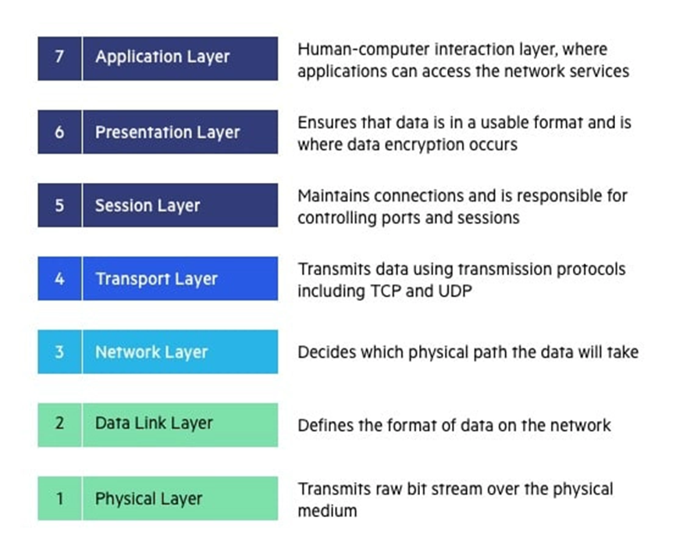
Open Systems Interconnection (OSI) model
We’ll describe OSI layers “top down” from the application layer that directly serves the end user, down to the physical layer.

Slide 4
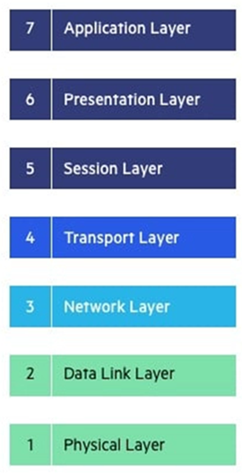
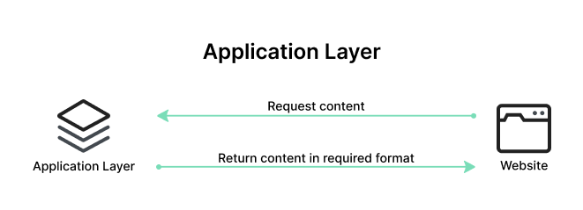
Open Systems Interconnection (OSI) model
7. Application Layer
The Application Layer serves as the interface between the end-user applications and the underlying network services.
This layer provides protocols and services that are directly utilized by end-user applications to communicate across the network.
Key functionalities of the Application Layer include resource sharing, remote file access, and network management.
Examples of protocols operating at the Application Layer include Hypertext Transfer Protocol (HTTP) for web browsing, File Transfer Protocol (FTP) for file transfers, Simple Mail Transfer Protocol (SMTP) for email services, and Domain Name System (DNS) for resolving domain names to IP addresses. These protocols ensure that user applications can effectively communicate with each other and with servers over a network.

Slide 5
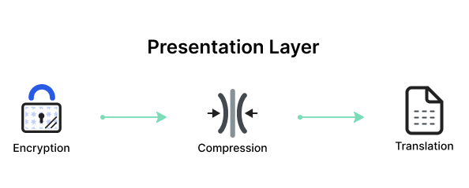
Open Systems Interconnection (OSI) model
6. Presentation Layer
The Presentation Layer, also known as the syntax layer, is responsible for translating data between the application layer and the network format.
It ensures that data sent from the application layer of one system is readable by the application layer of another system. This layer handles data formatting, compression, and encryption, facilitating interoperability between different systems.
One of the key roles of the Presentation Layer is data translation and code conversion. It transforms data into a format that the application layer can understand. For example, it may convert data from ASCII to EBCDIC. It also includes encryption protocols to ensure data security during transmission and compression protocols to reduce the amount of data for efficient transmission.

Slide 6
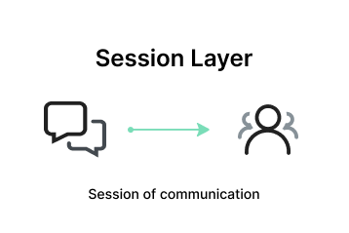
Open Systems Interconnection (OSI) model
5. Session Layer
The Session Layer manages and controls the connections between computers. It establishes, maintains, and terminates connections, ensuring that data exchanges occur efficiently and in an organized manner.
The layer is responsible for session checkpointing and recovery, which allows sessions to resume after interruptions.
Protocols operating at the Session Layer include Remote Procedure Call (RPC), which enables a program to execute a procedure on a remote host as if it were local, and the session establishment phase in protocols like NetBIOS and SQL. These services enable reliable communication, especially in complex network environments.

Slide 7
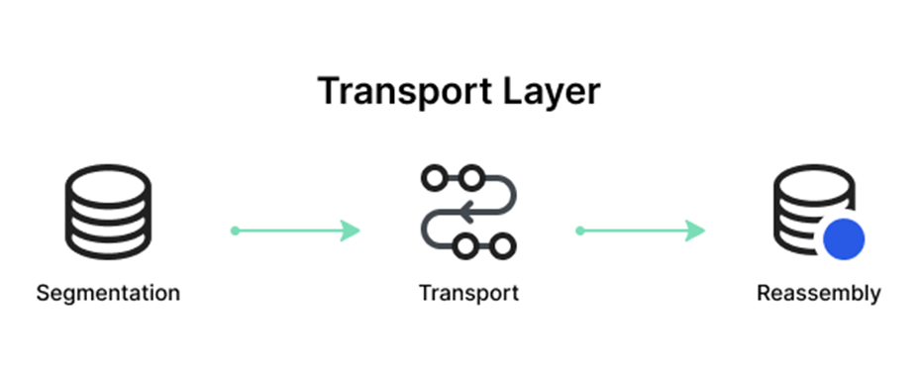
Open Systems Interconnection (OSI) model
4. Transport Layer
The Transport Layer provides end-to-end communication services for applications. It ensures complete data transfer, error recovery, and flow control between hosts.
This layer segments and reassembles data for efficient transmission and provides reliability with error detection and correction mechanisms.
Protocols at this layer include Transmission Control Protocol (TCP) and User Datagram Protocol (UDP). TCP is connection-oriented and ensures reliable data transfer with error checking and flow control, making it suitable for applications like web browsing and email. UDP is connectionless, offering faster, though less reliable transmission, suitable for applications like video streaming and online gaming.

Slide 8
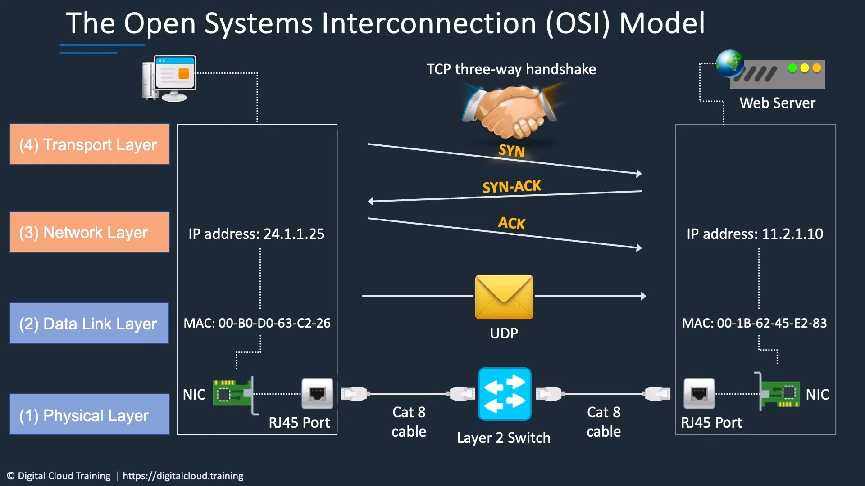

Slide 9
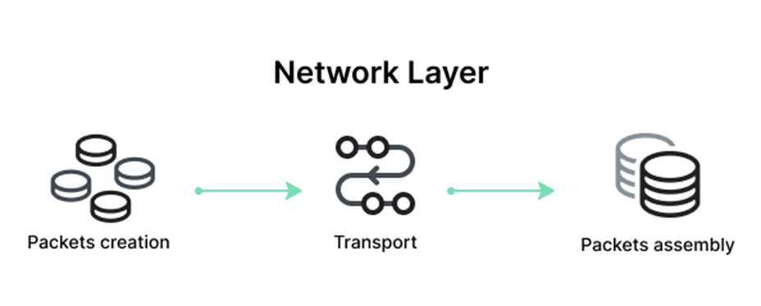
Open Systems Interconnection (OSI) model
3. Network Layer
The Network Layer is responsible for data routing, forwarding, and addressing.
It determines the best physical path for data to reach its destination based on network conditions, the priority of service, and other factors. This layer manages logical addressing through IP addresses and handles packet forwarding.
Key protocols at this layer include the Internet Protocol (IP), which is important for routing and addressing, Internet Control Message Protocol (ICMP) for diagnostic and error-reporting purposes, and routing protocols like Routing Information Protocol (RIP) that manage the routing of data across networks.

Slide 10
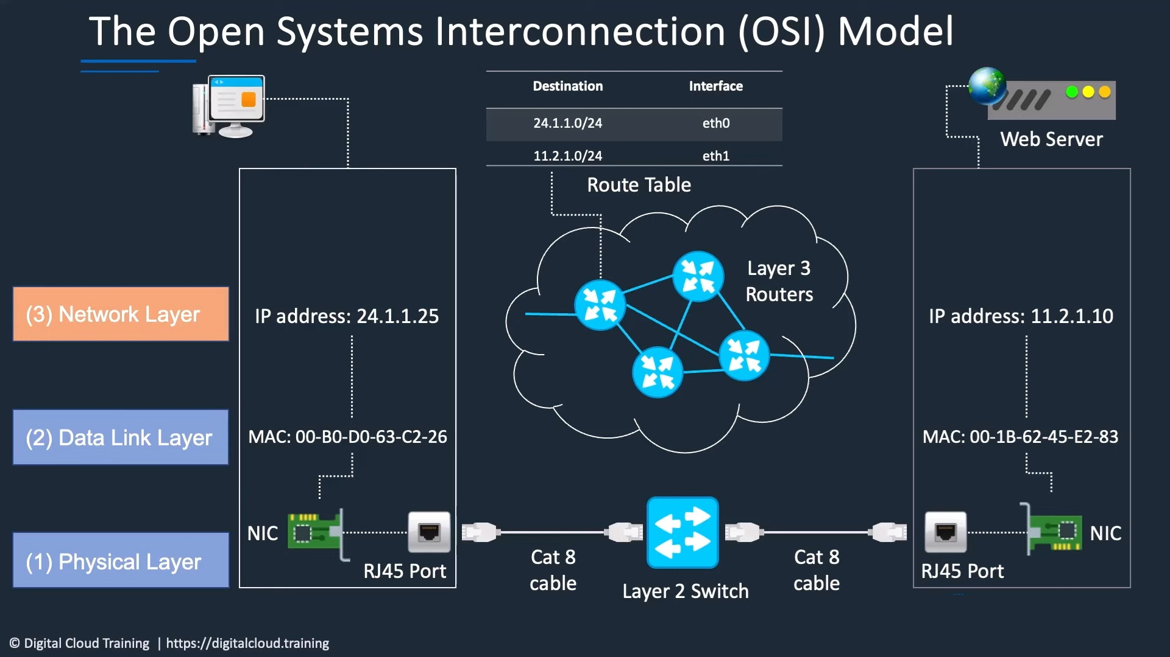

Slide 11
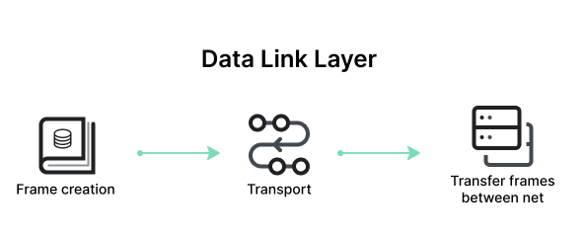
Open Systems Interconnection (OSI) model
2. Data Link Layer
The Data Link Layer is responsible for node-to-node data transfer and error detection and correction. It ensures that data is transmitted to the correct device on a local network segment.
This layer manages MAC (Media Access Control) addresses and is divided into two sublayers: Logical Link Control (LLC) and Media Access Control (MAC).
Protocols and technologies at this layer include Ethernet, which defines the rules for data transmission over local area networks (LANs), and Point-to-Point Protocol (PPP) for direct connections between two network nodes. It also includes mechanisms for detecting and possibly correcting errors that may occur in the Physical Layer.

Slide 12
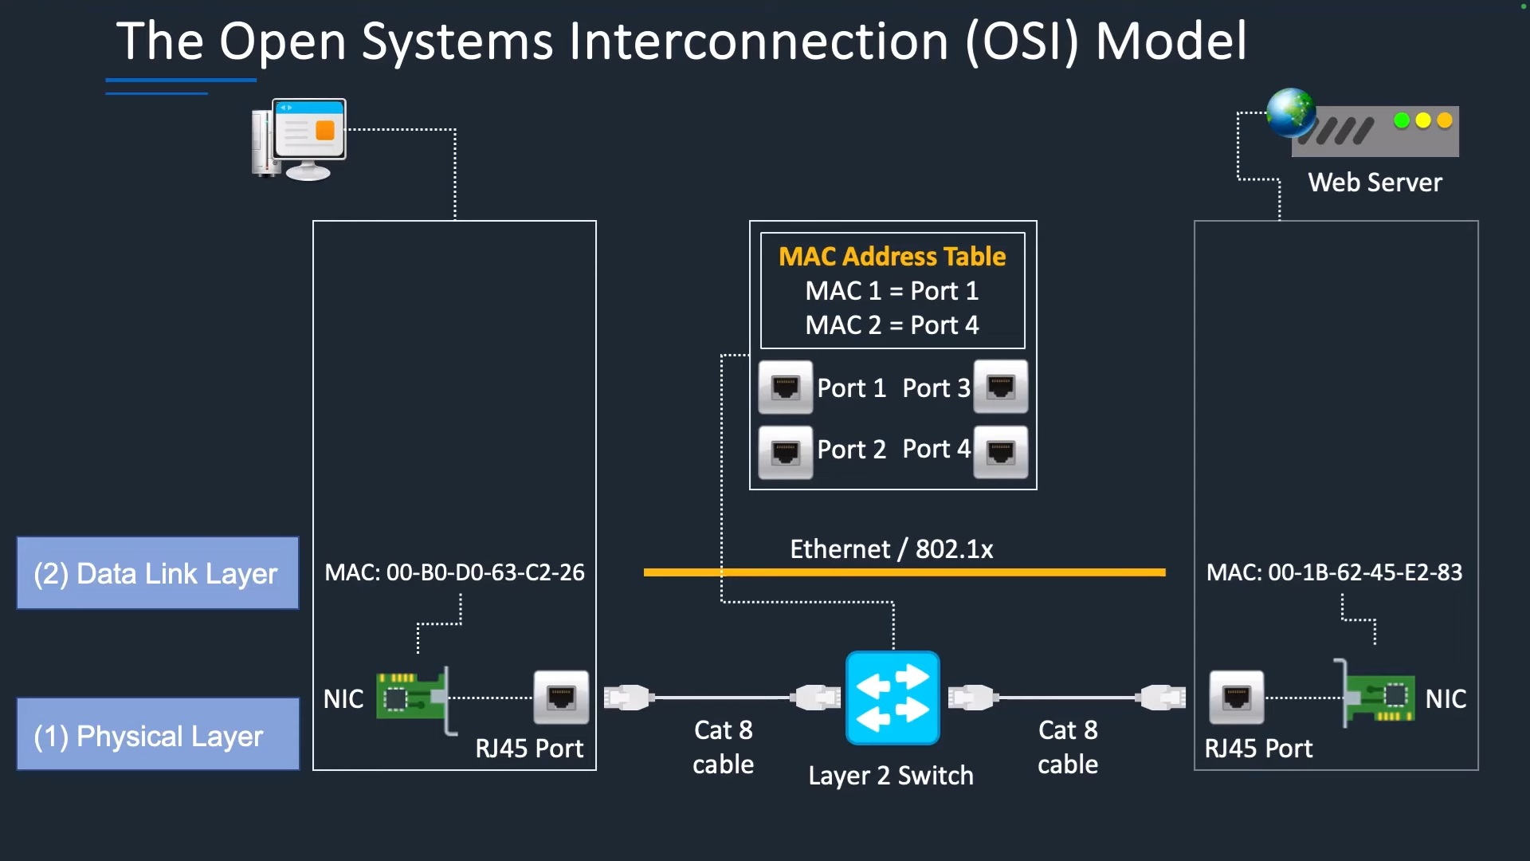

Slide 13
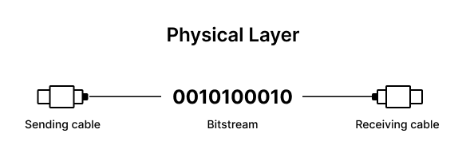
Open Systems Interconnection (OSI) model
1. Physical Layer
The Physical Layer is responsible for the physical connection between devices.
It defines the hardware elements involved in the network, including cables, switches, and other physical components. This layer also specifies the electrical, optical, and radio characteristics of the network.
Functions of the Physical Layer include the modulation, bit synchronization, and transmission of raw binary data over the physical medium. Technologies such as Fiber Optics and Wi-Fi operate at this layer, ensuring that the data physically moves from one device to another in the network.

Slide 14
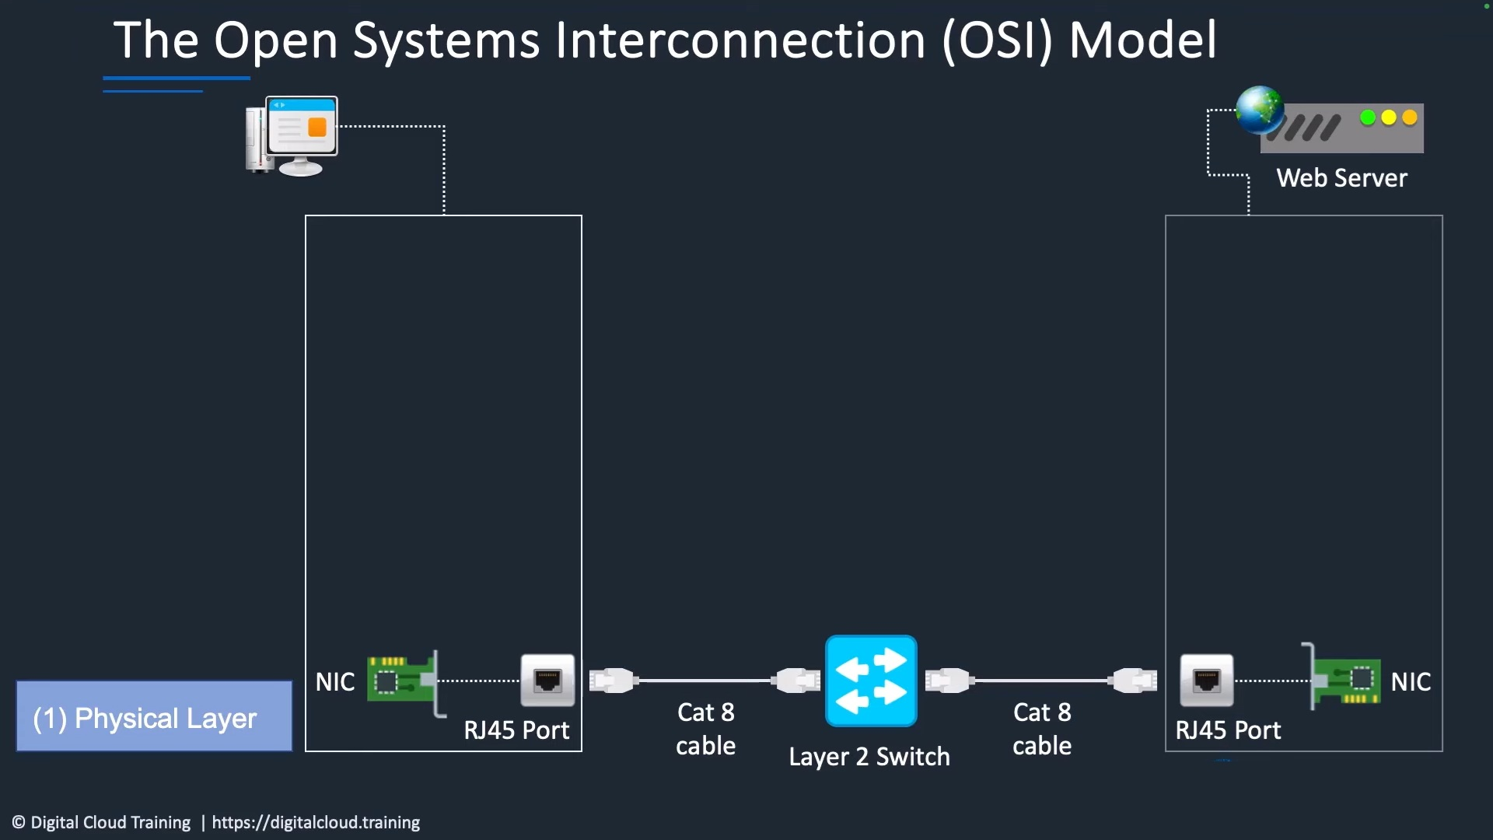

Slide 15
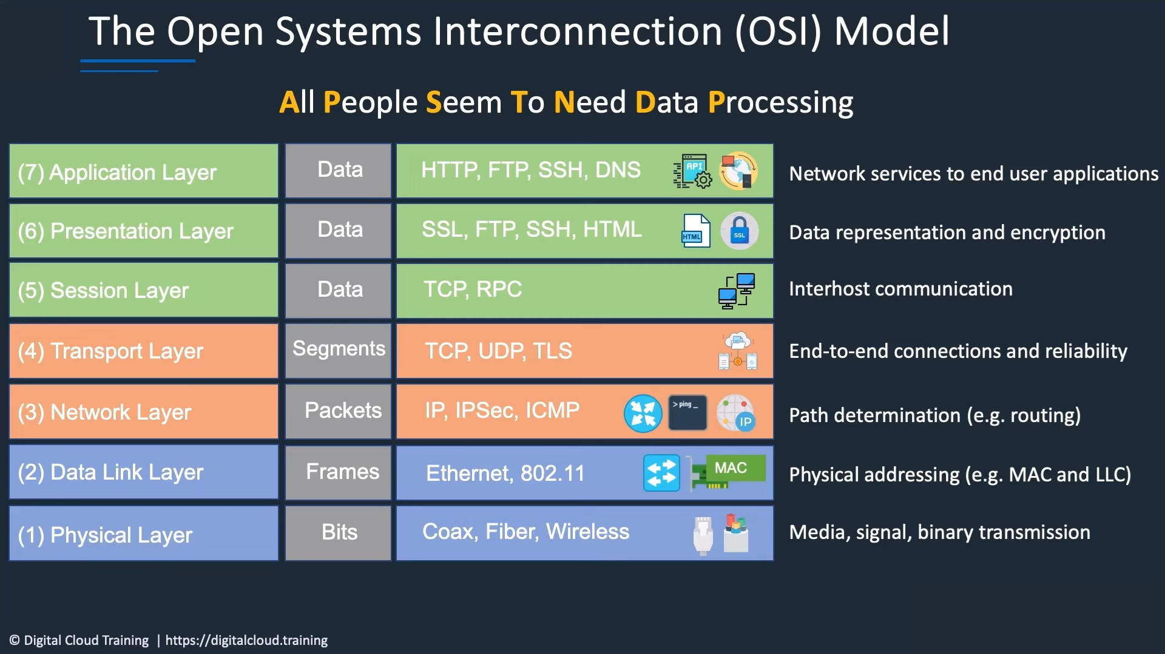

Slide 16
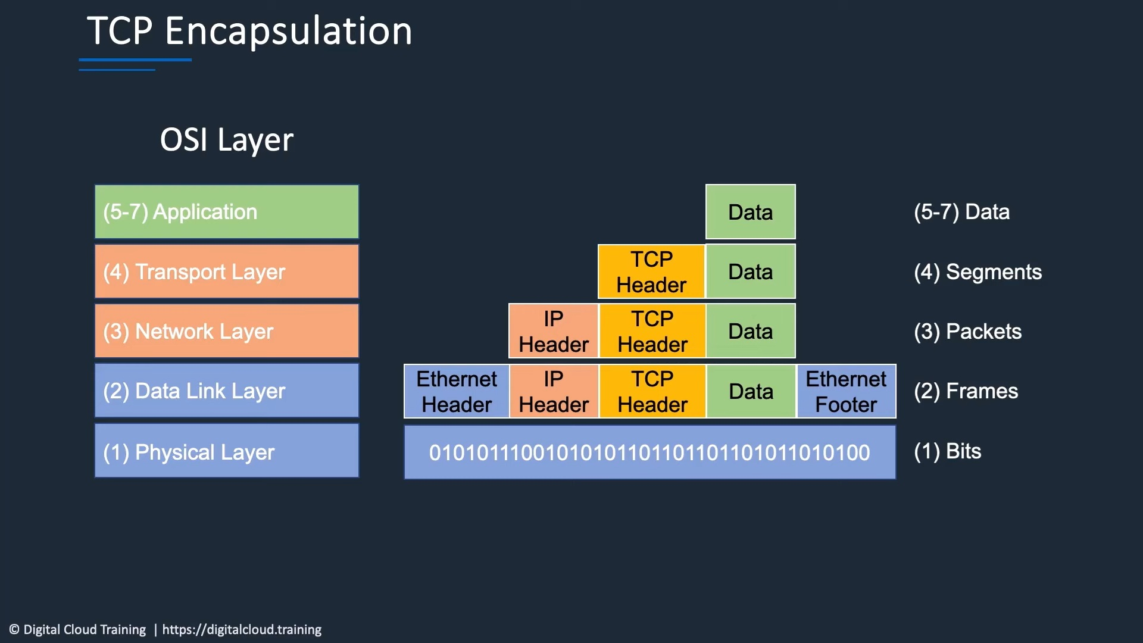

Slide 17
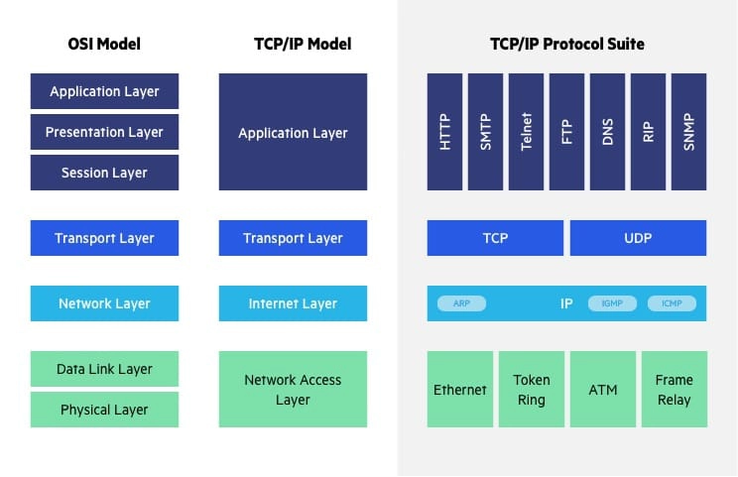
OSI vs. TCP/IP Model

Slide 18
Transfer Control Protocol/Internet Protocol (TCP/IP)
The Transfer Control Protocol/Internet Protocol (TCP/IP) is older than the OSI model and was created by the US Department of Defense (DoD). A key difference between the models is that TCP/IP is simpler, collapsing several OSI layers into one:
OSI layers 5, 6, 7 are combined into one Application Layer in TCP/IP
OSI layers 1, 2 are combined into one Network Access Layer in TCP/IP – however TCP/IP does not take responsibility for sequencing and acknowledgement functions, leaving these to the underlying transport layer.
Other important differences:
TCP/IP is a functional model designed to solve specific communication problems, and which is based on specific, standard protocols. OSI is a generic, protocol-independent model intended to describe all forms of network communication.
In TCP/IP, most applications use all the layers, while in OSI simple applications do not use all seven layers. Only layers 1, 2 and 3 are mandatory to enable any data communication.

